Slide 1
Image Segmentation using Pillar k-Means
Venkat Vaddula

Slide 2
Contents
Introduction
Image Segmentation
Some Existing Image Segmentation Methods
K-Means Clustering Algorithm
Pillar K-means
K-Means in Image Segmentation
About my Project
Preliminary Results
References

Slide 3
Introduction
Based on a paper “A New Approach for Image Segmentation using Pillar
K-means Algorithm” by Ali Ridho Barakbah and Yasushi Kiyoki
Designed a relatively new technique for segmentation, Pillar K-Means Algorithm
Compared it to different Image segmentation algorithms like K-means and Gaussian Mixture Model algorithm and involving RGB, HSV, HSL and CIELAB color spaces.
Their experimental results clarify the effectiveness of Pillar K means to improve the segmentation quality in aspects of precision and computational time.
Notes:
Edge Detection Algorithms
thresholding, region growing, splitting, and merging
Region Based algorithms

Slide 4
Image Segmentation
Image Segmentation is the process that partitions R into R1, R2, R3….,Rn
How?
Based on properties of image intensity
Discontinuity: Segmenting based on changes in abrupt changes in intensity
Similarity: Segmenting based on predefined criteria
Why?
Applications
Object Recognition
Medical Imaging
Create 3D Reconstructs
Machine Vision
Recognition Tasks

Slide 5
Some Existing Image Segmentation Methods
Graph Based Image Segmentation
Watershed transformation
Region Growing
Binary (Histogram-based) Segmentation
K-Means Clustering
Compression Based Methods
Notes:
Edge Detection Algorithms
thresholding, region growing, splitting, and merging
Region Based algorithms

Slide 6
K-Means Algorithm
K-means is a unsupervised machine learning clustering algorithm
It is used to cluster the data into k clusters
How does it cluster:
Based on number of clusters it just assumes and divides the data
It then tries to optimize the clusters iteratively
Notes:
Then the algorithm iterates through the all the data points assigning each point to one of the k clusters based on the distance

Slide 7

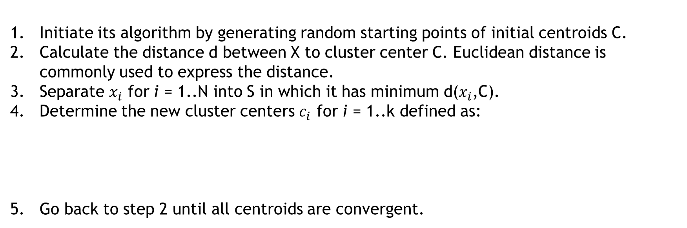
K-Means Algorithm
Initiate its algorithm by generating random starting points of initial centroids C.
Calculate the distance d between X to cluster center C. Euclidean distance is commonly used to express the distance.
Separate $x_{i}$ for i = 1..N into S in which it has minimum d($x_{i}$,C).
Determine the new cluster centers $c_{i}$ for i = 1..k defined as:
5. Go back to step 2 until all centroids are convergent.
Notes:
Then the algorithm iterates through the all the data points assigning each point to one of the k clusters based on the distance

Slide 8
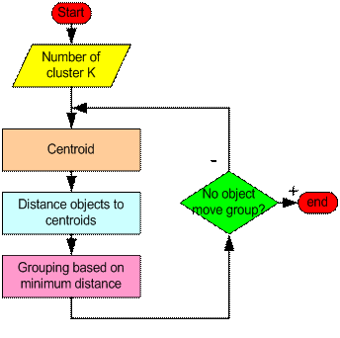
K-Means Algorithm

Slide 9
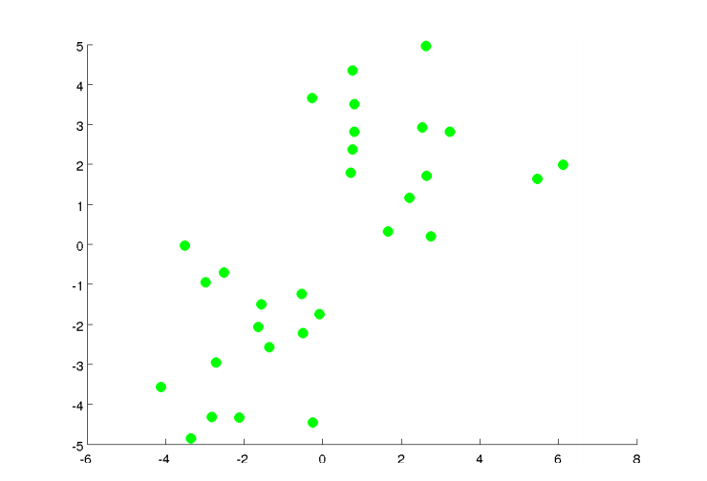
K-Means Algorithm

Slide 10
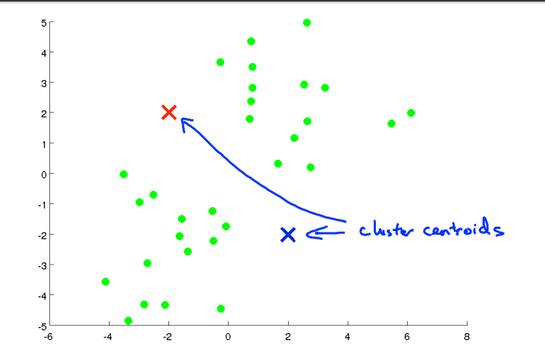
K-Means Algorithm

Slide 11
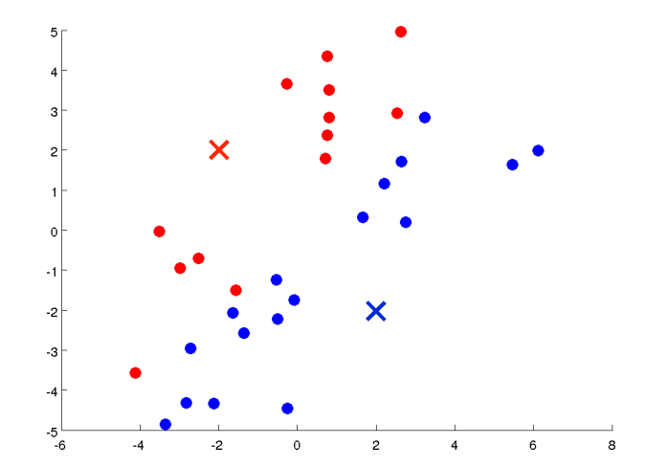
K-Means Algorithm

Slide 12
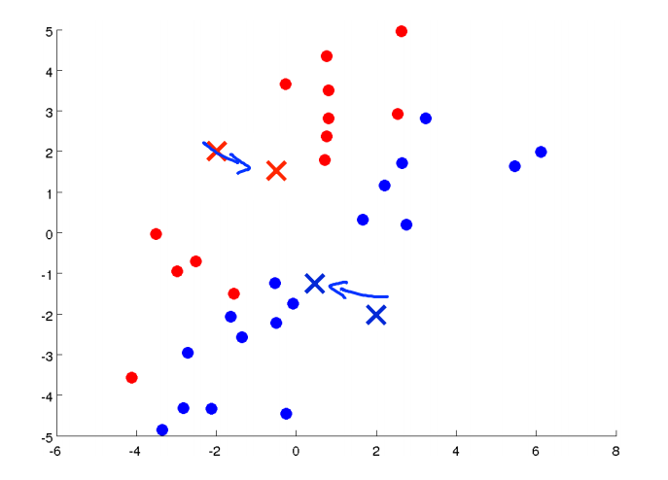
K-Means Algorithm

Slide 13
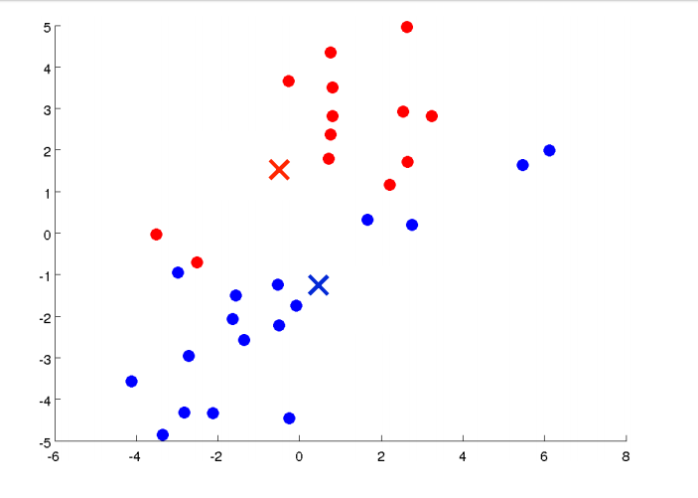
K-Means Algorithm

Slide 14
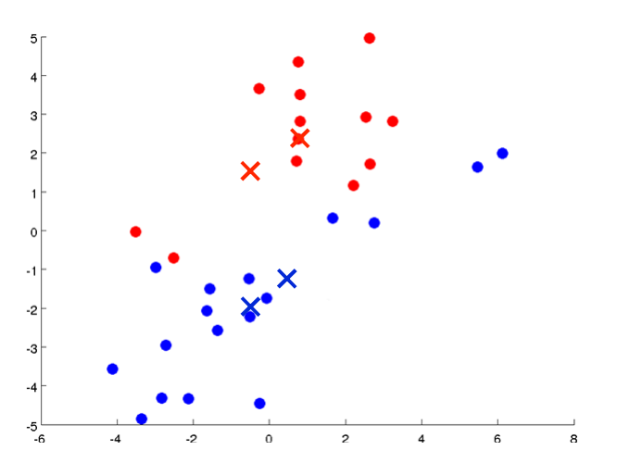
K-Means Algorithm

Slide 15
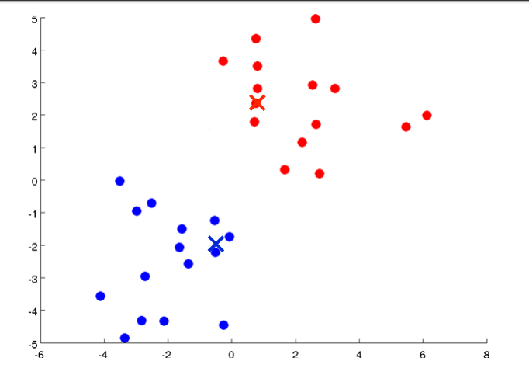
K-Means Algorithm

Slide 16
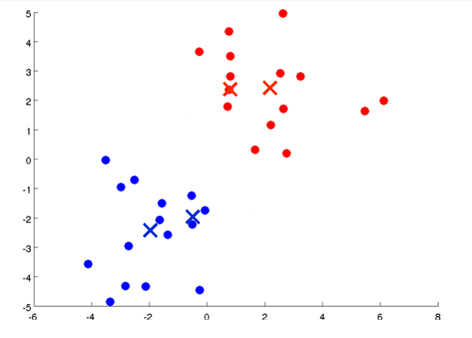
K-Means Algorithm

Slide 17
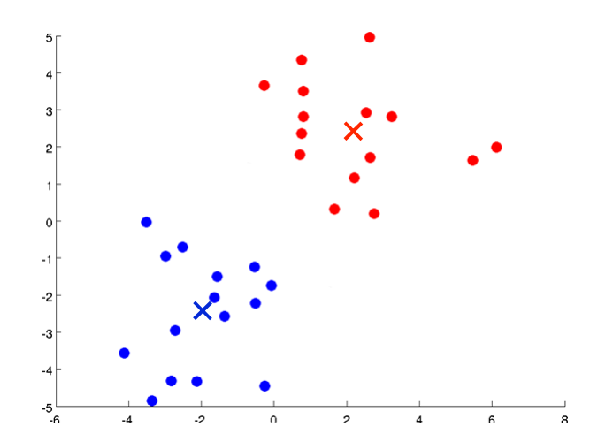
K-Means Algorithm

Slide 18
K-Means Algorithm

Slide 19
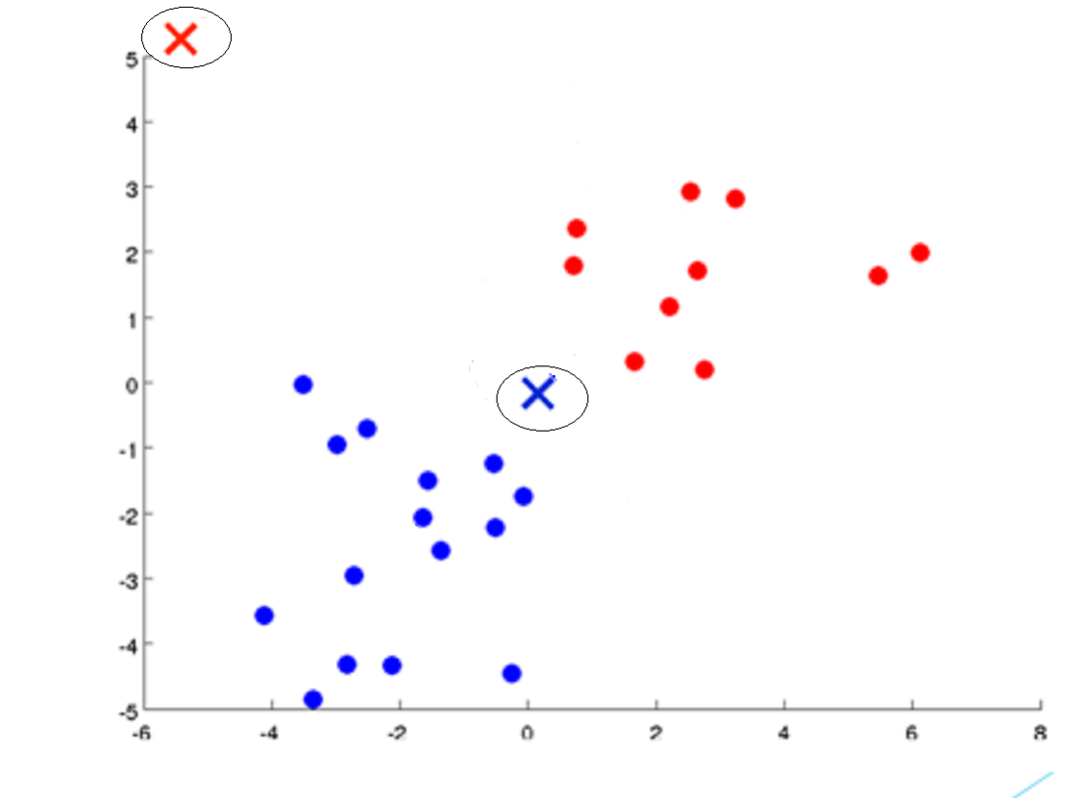
What if ?

Slide 20
K-Means Algorithm – not so good!
The K-Means algorithm is not the best method for segmentation
It depends on the initial placement of the centroids
Pillar Algorithm is used in optimizing the placement of initial centroids
Pillar Algorithm is inspired from the idea of set of pillars’, their placement to make a stable house or a building.
Developed by the same people
Ali Ridho Barakbah and Yasushi Kiyoki, A Pillar Algorithm for K-Means Optimization by Distance Maximization for Initial Centroid Designation, World Academy of Science, Engineering and Technology Computational Intelligence and Data Mining, 2009. CIDM '09. IEEE Symposium

Slide 21
What is Pillar K-Means Algorithm?
Pillar K-Means algorithm is just the K-means after being optimized by Pillar Algorithm
The Pillar algorithm is very robust and superior for initial centroids optimization for K-means by positioning all centroids far separately among them in the data distribution.

Slide 22
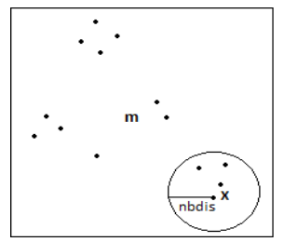
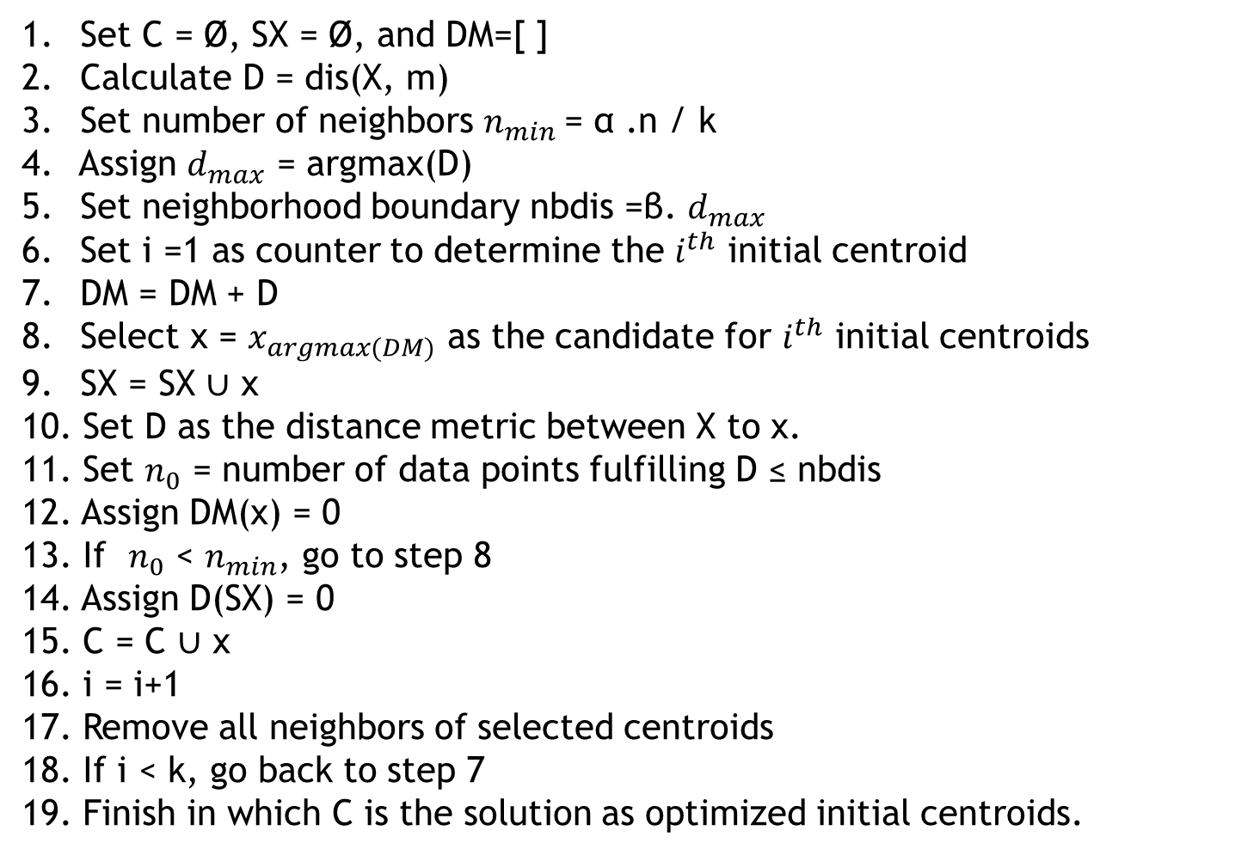
Set C = Ø, SX = Ø, and DM=[ ]
Calculate D = dis(X, m)
Set number of neighbors $n_{min}$= α .n / k
Assign $d_{max}$ = argmax(D)
Set neighborhood boundary nbdis =β. $d_{max}$
Set i =1 as counter to determine the $i^{th}$ initial centroid
DM = DM + D
Select x = $x_{argmax(DM)}$ as the candidate for $i^{th}$ initial centroids
SX = SX ∪ x
Set D as the distance metric between X to x.
Set $n_{0}$ = number of data points fulfilling D ≤ nbdis
Assign DM(x) = 0
If $n_{0}$ < $n_{min}$, go to step 8
Assign D(SX) = 0
C = C ∪ x
i = i+1
Remove all neighbors of selected centroids
If i < k, go back to step 7
Finish in which C is the solution as optimized initial centroids.

Slide 23
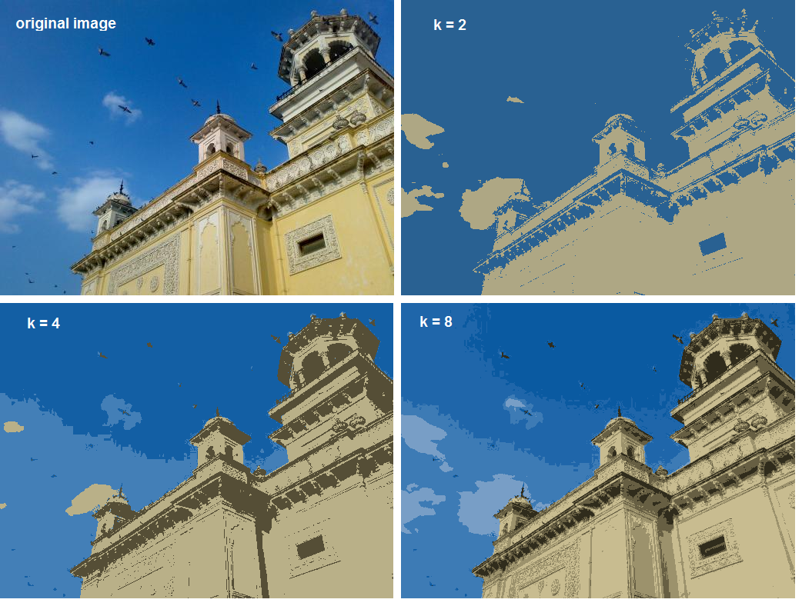
K-Means in image segmentation
K-means can be used in
Image segmentation
Images consist of pixels
which acts as data points
Each pixel has values
Based on number of classes

Slide 24
Project
To Apply the Pillar K-Means in a variety of fields like Medical, Object Detection
Compare Pillar K means to k-means on different terms
How well it segments
Computation Time
Cost
Segmentation in different Color spaces

Slide 25
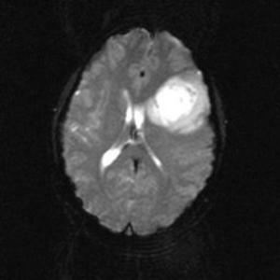
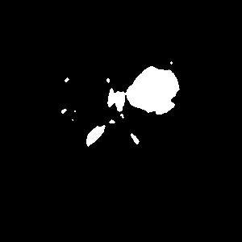
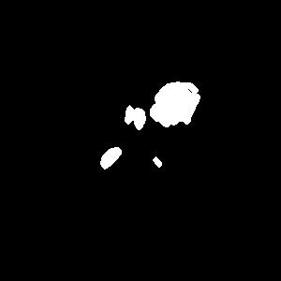
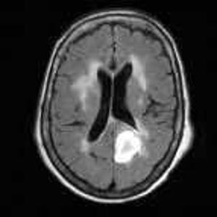


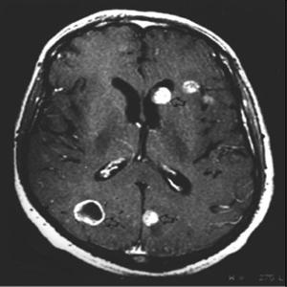
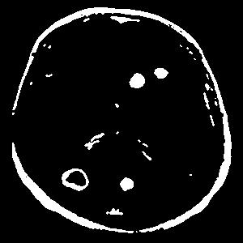

Preliminary Results
Name | Original Image | K-Means | Pillar K-Means
1.
2.
3.

Slide 26
What’s Next?
Trying to implement on different images like to extract the article from old digitized newspaper
With another algorithm, thinking of C- Means
Comparison of K-means and Pillar K-means
On different color models

Slide 27
References
Ali Ridho Barakbah and Yasushi Kiyoki, A New Approach for Image Segmentation using Pillar-Kmeans Algorithm, World Academy of Science, Engineering and Technology International Journal of Electrical, Computer, Energetic, Electronic and Communication Engineering Vol:3, No:11, 2009
Andrew Ng, Associate Professor, Stanford University; Former Chief Scientist, Baidu; Chairman and Co-founder, Coursera-Machine Learning - Week 8, Lecture 13
Ali Ridho Barakbah and Yasushi Kiyoki, A Pillar Algorithm for K-Means Optimization by Distance Maximization for Initial Centroid Designation, World Academy of Science, Engineering and Technology Computational Intelligence and Data Mining, 2009. CIDM '09. IEEE Symposium
VidyaSagar, Bhujanga Rao, Madhu, Brain Tumor detection and its area estimation in MRI images using pillar k-means algorithm, International Journal of Engineering Sciences Research-IJESR, ISSN: 2230-8504; e-ISSN-2230-8512; Vol 05, Article 03345; March 2014

